Slide 1
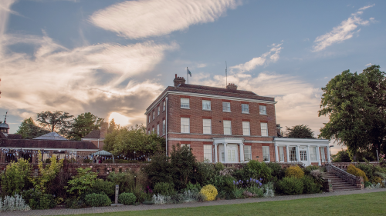


East Grinstead Town Council Sustainability Proposal
Prepared by Southern Sheeting Supplies Ltd

Slide 2

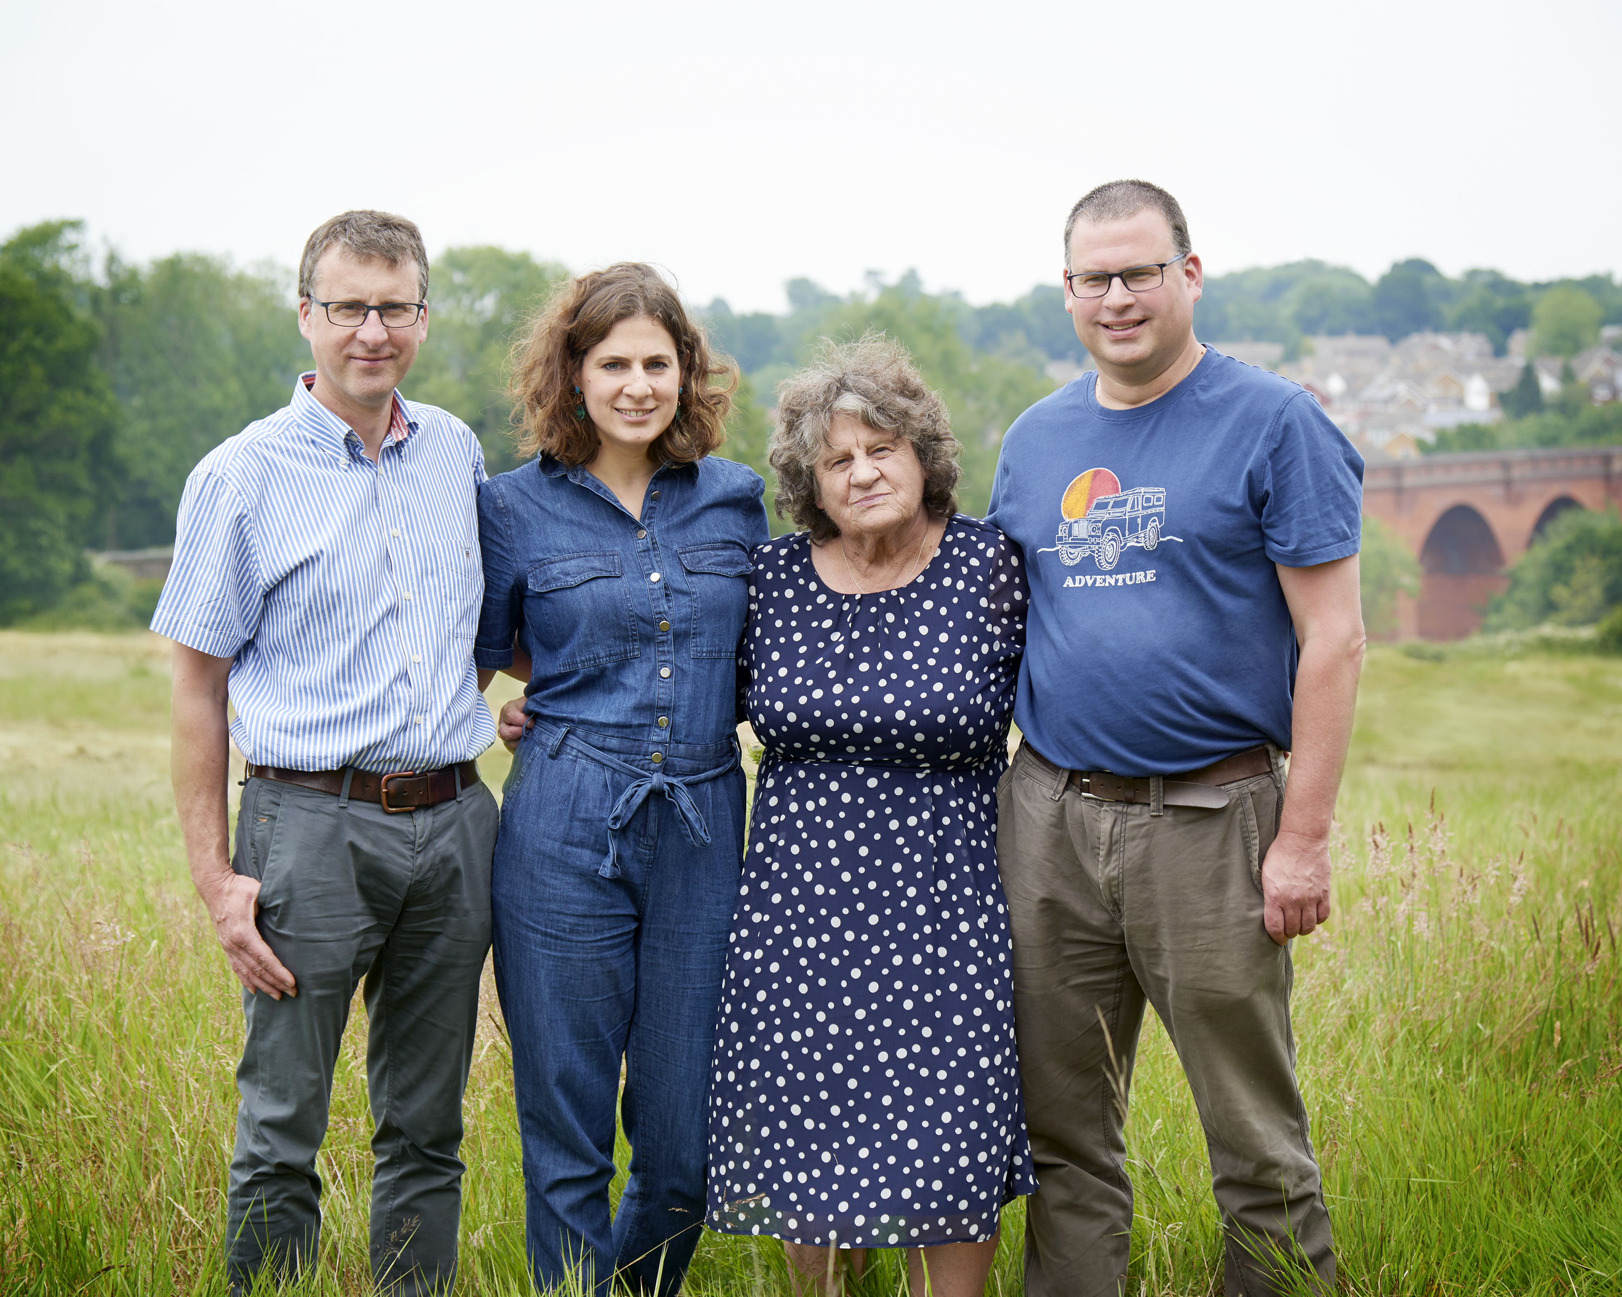
Who are we?
The Hobbs family have lived and worked in East Grinstead for 3 generations.
Started farming in 1969 and branched out into new business enterprises now employing 75 people
L C Hobbs & Son Ltd
1969 – Present
Southern Sheeting Supplies Ltd
1979 – Present
Deers Leap Park
1996 – Present
South-East Fabricators Ltd
2008 – Present

Slide 3
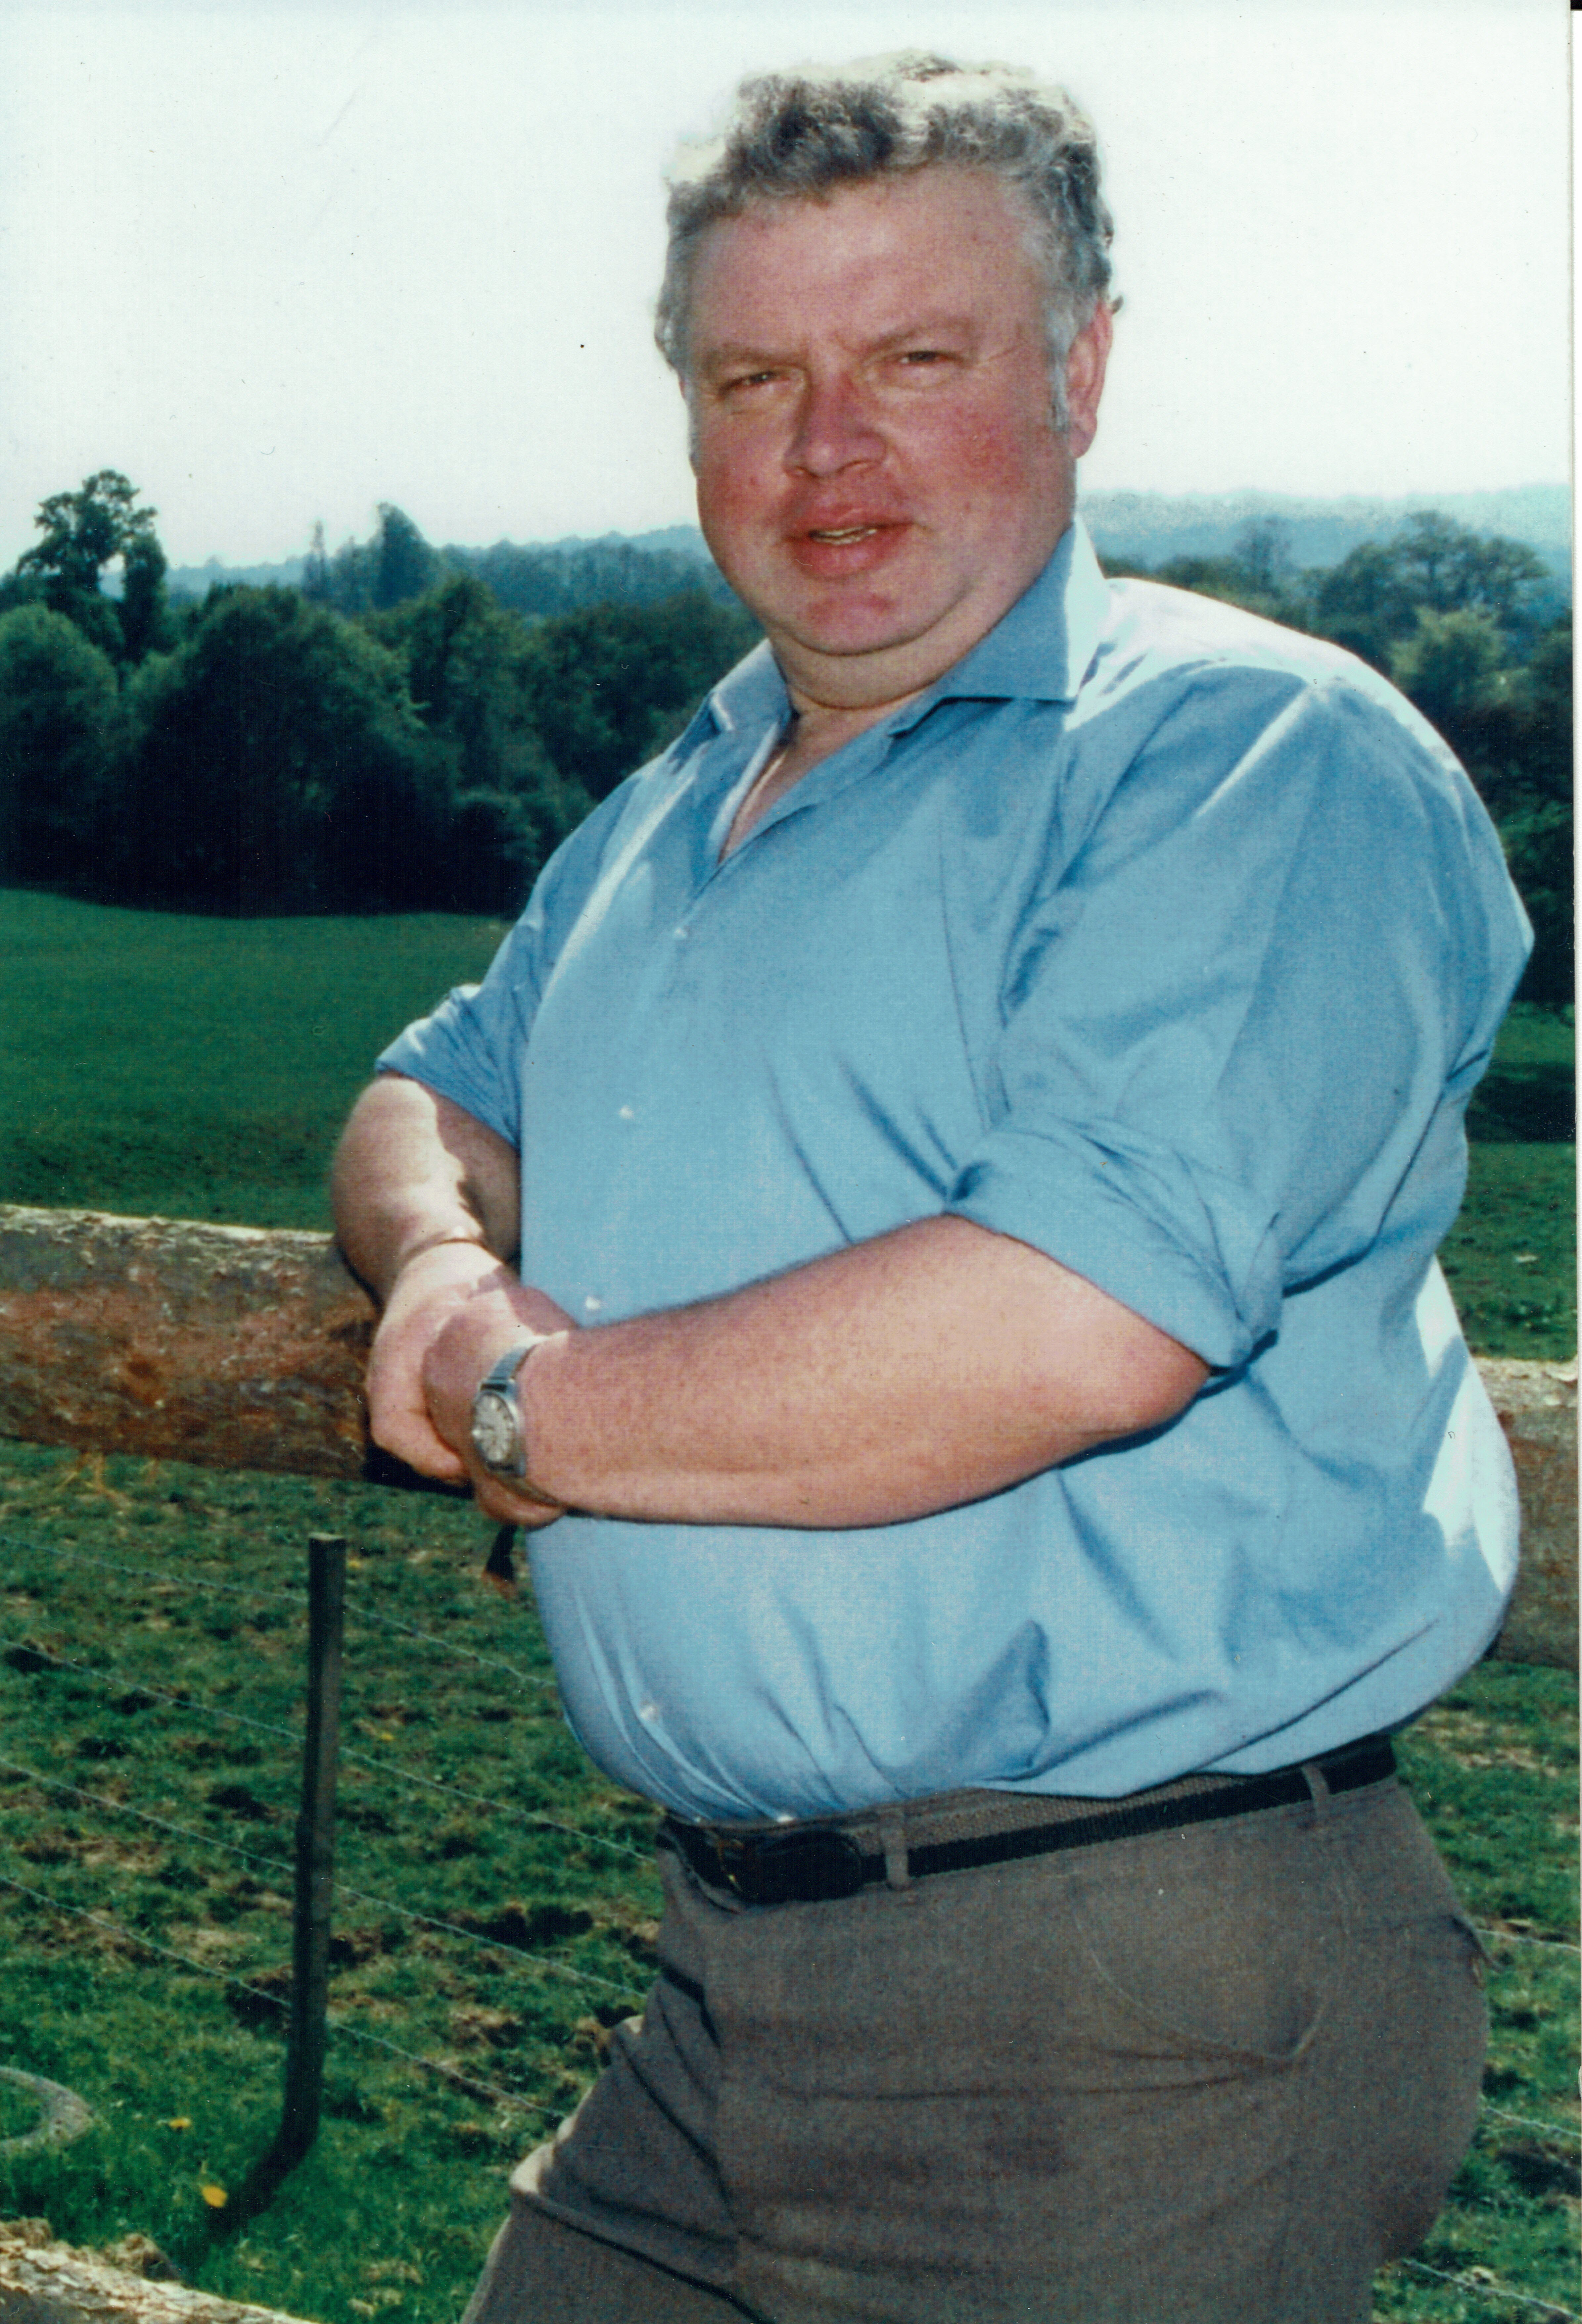
Tom Hobbs
Established L C Hobbs & Sons 1969
Active member of National Farmer Union
School Governor for 20+ years of Sackville & Chequer Mead/ The Meads
Founded Southern Sheeting Supplies 1979
Founded Deers Leap Bike Park 1995

Slide 4
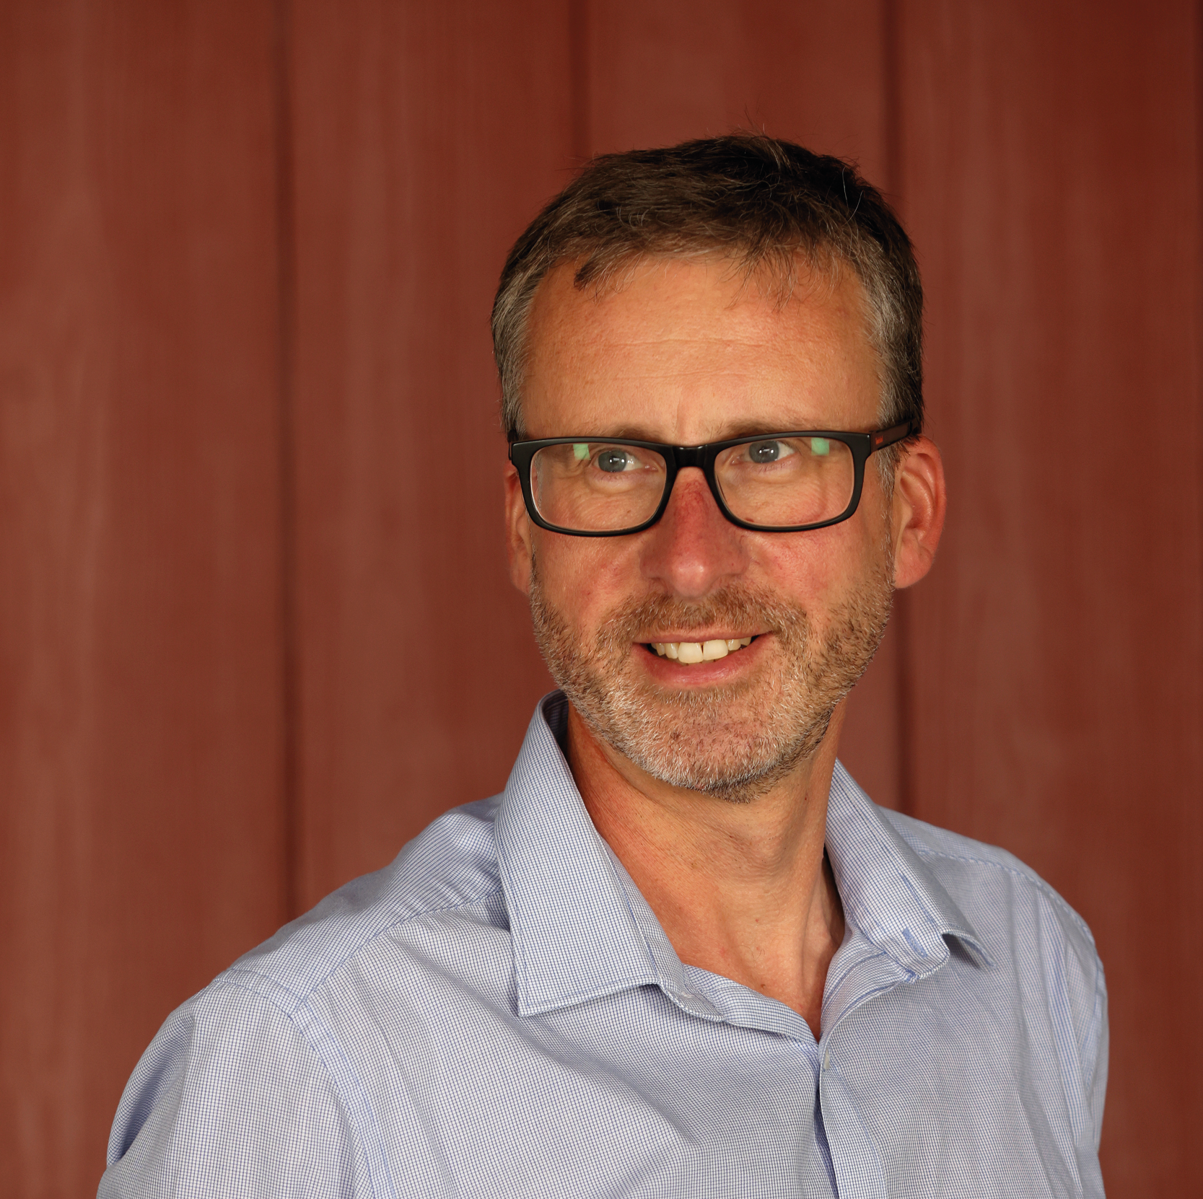
Tony Hobbs
MD of Southern Sheeting since 1997
Grown Southern Sheeting from £1.5m to £20m+ and 7 employees to 65+
Manages 300Ac across 3 farms around East Grinstead
Director of South East Fabricators
Active Scouting & Girlguiding Leader for 25 years
Loves the natural environment; keen walker & gardener

Slide 5
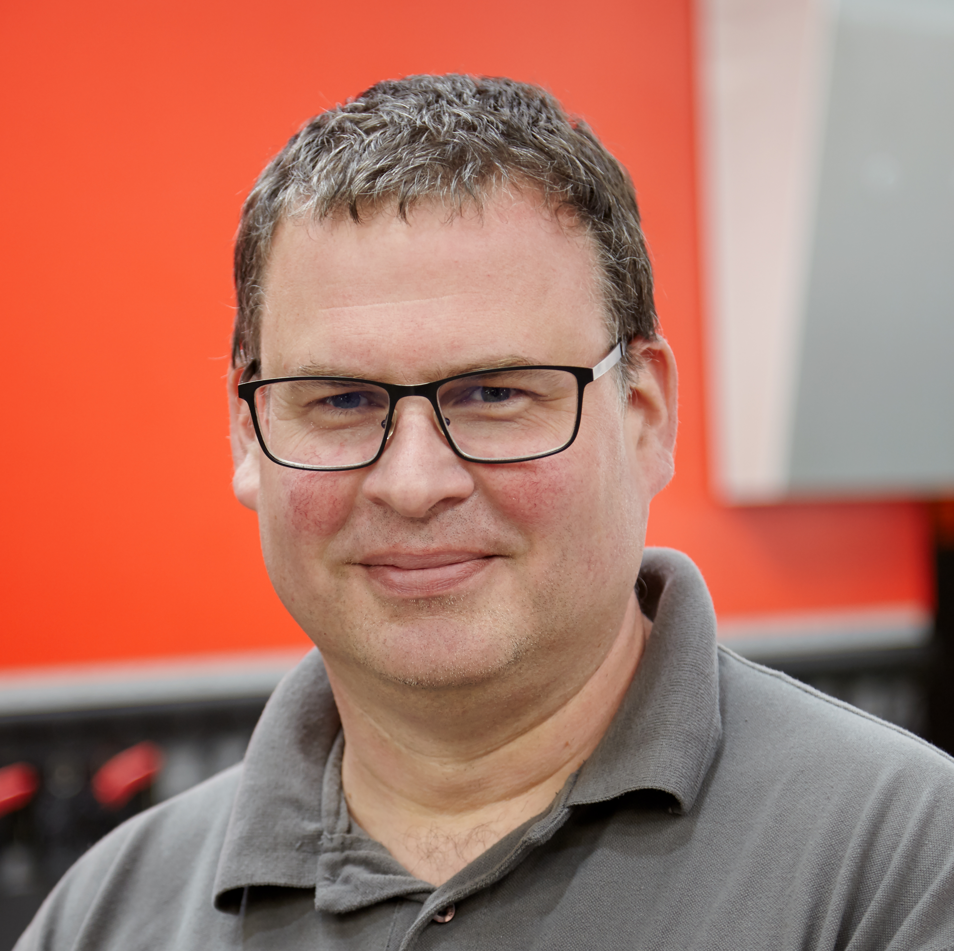
Nick Hobbs
Founded South East Fabricators 2010 (sheet metal fabrication)
Employs 14 local staff, 8 of whom live in East Grinstead
Director of Southern Sheeting
Member of Rotary Club
Enjoys militaria and gardening

Slide 6
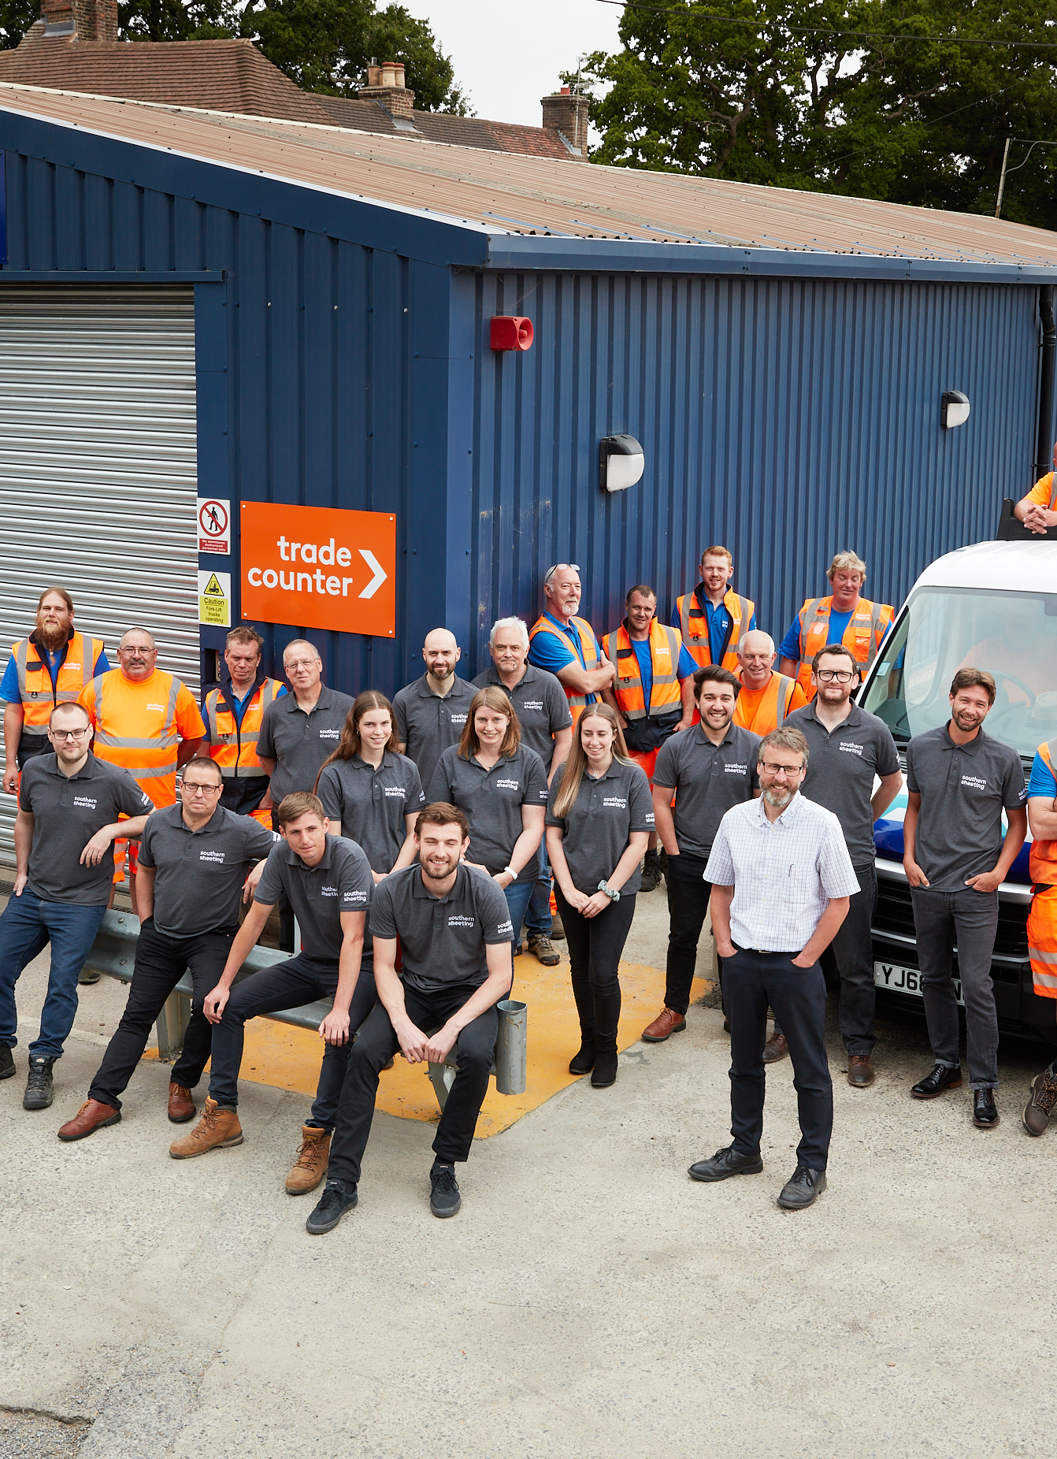
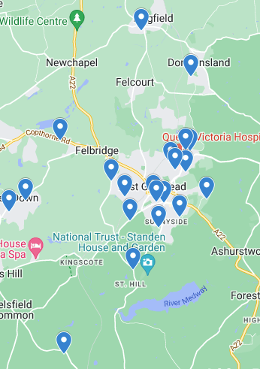
Staff locations local to East Grinstead
Who are Southern Sheeting ?
The Company
Two East Grinstead based depots
New Midlands depot opened 2023
Employs 65 staff, most of whom live locally
£20m Turnover 2022/23
Rated 4.9 on Trustpilot
The Community
Supporters of several charities and volunteering days for :
EG Lions Club
Crawley Open House
Bluebell Railway
Ashdown Forest Conservators
Golden Lions Children’s trust
East Park - Riding for the Disabled

Slide 7

Why are we here?
In 2019 we launched our 5-year Growth Plan:
    National Expansion
    Best in Class eCommerce
    Market Focussed
    Customer Promises
In 2022 we added:
    Grow and Value Our People
In 2023 we added:
    Sustainability

Slide 8
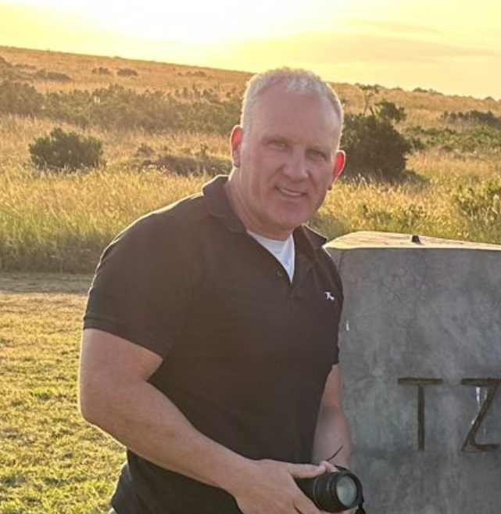
Consultant Operations Director
Martin Clay
ASDA - Head of Distribution Non Food
New Look - Supply Chain Management
NRS Healthcare – Supply Chain/Logistics
P/T Lecturer Loughborough University
(Retailing, eCommerce & Sustainability)

Slide 9

Our work programme…
Our SUSTAINABILITY WORKSTREAMS:
  UK Logistics (Operations)
  International Supply Chain
  Admin, Premises & IT
  Circularity
  Employees & Community
  We are here delivering against our
  Employees & Community outreach programme – to make a positive difference
  Engaged with EGTC (Julie & Harry) to see
  what opportunities may exist
  Became apparent the EGTC sustainability
  programme was thin (tactically orientated)
  SSS believe it can assist EGTC in this area

Slide 10

Recommended Approach
What might the first steps be….
Create and publish Mission Statement
Create and publish Sustainability Policy
Audit Policies
& Embed into everyday Functions
Establish five Sustainability Pillars

Slide 11
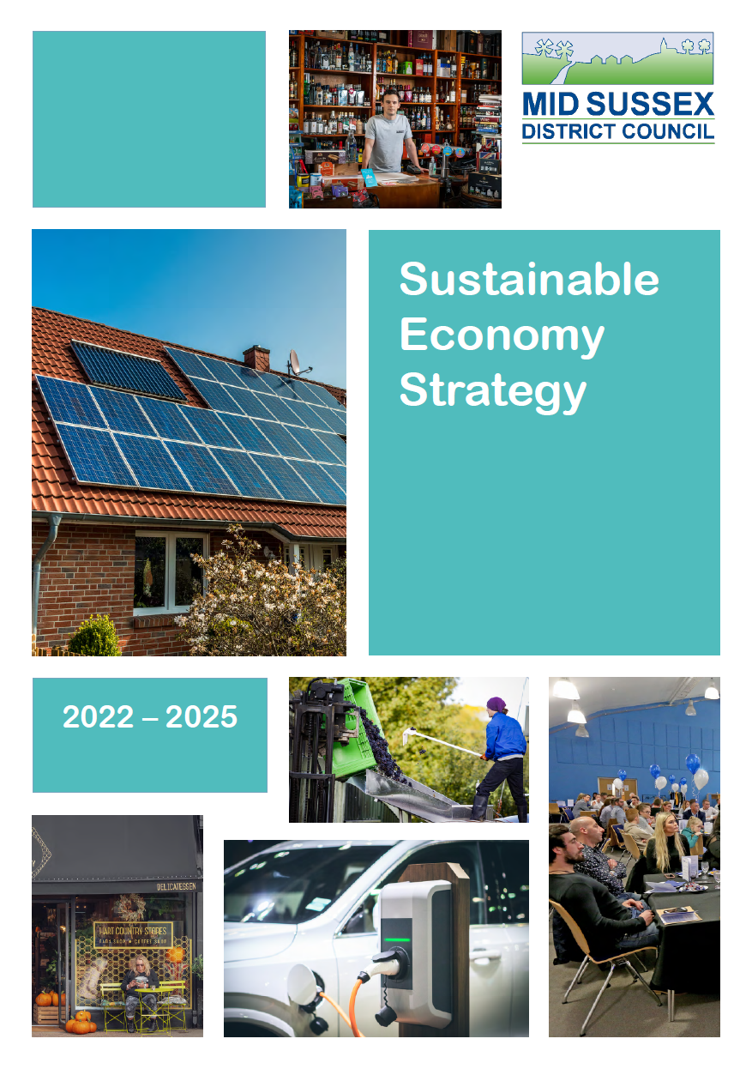
Recommendation….
It is recommended that the EGTC Sustainability Strategy is developed with regard to the MSDC Sustainable Economy Strategy.
The Vision:
A vibrant District that is attractive, resilient and innovative that balances social well-being, environmental protection and sustainable economic growth.
The Themes:
The Sustainable Economy Strategy sets out the Council’s priorities for the next three years under the three core themes: People, Place and Partnership.
The Strategic Objectives:
There are a total of 14 objectives within the Action Plan for the period up to 2025 informed and guided by the 17 United Nations Sustainability Goals

Slide 12
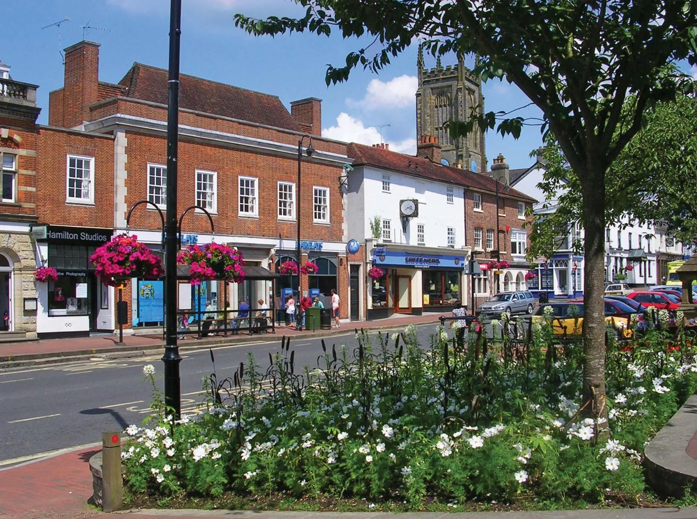
Create & Publish a Mission Statement
Our mission is to make our town a more sustainable and thriving place for everyone. We will do this by promoting sustainability in everything we do, from our upstream supply chain and service agreements, to our downstream service delivery. Our goal is to make a positive difference locally, nationally and internationally.

Slide 13
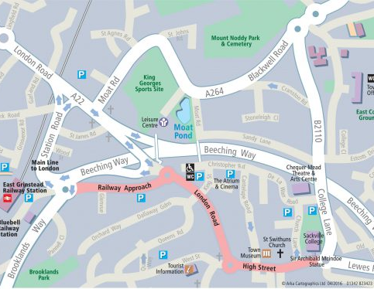

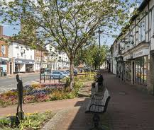
Create and Publish a Sustainability Policy
Create the policy which sets out the specific rules, principles and guidelines to help in decision-making and governance of the EGTC operation
The following five Key Pillars may be inferred:
  1. Natural Environment
  2. Community Wellbeing
  3. Investing in our Community
  4. Sustainable Energy
  5. Recycling & Circularity

Slide 14
Establish five sustainability pillars that align with the Mission Statement, Policy and the MSDC Sustainable Economic Strategy
Natural Environment
Community Wellbeing
Investing in our community
Sustainable Energy
Recycling
& Circularity
Enriching our current green assets to support nature's well-being, while actively promoting biodiversity through the creation of nature-friendly habitats
Promoting the expansion of opportunities that support self-care, personal health, and the welfare of our community
Empowering the community with diverse opportunities to cultivate a sense of place, belonging, meaningful connection and a shared community belief.
Meet our energy needs by harnessing clean, reliable & sustainable sources while embracing a commitment to future generations
Championing recycling solutions, optimising resource usage, and fostering a circular economy

Slide 15
Potential Focus Areas
 | Pillar 1 Natural Environment | Pillar 2 Community Health | Pillar 3 Reimbursing the community | Pillar 4 Energy | Pillar 5 Recycling & Sustainability
1. | Turners Hill Road Recreation Ground | Community Cycles | Repair café | Renewable energy generation & purchase | Educating the community
2. | Queens Road Cemetery | Outdoor gym equipment | Community & Environmental Grants | Net zero energy use in delivery of services | Waste reduction & processing
3. | St Margarets Loop | Local maps | Youth facilities and engagement |  | Sustainable sourcing

Slide 16
Pillar One – The Natural Environment
Turners Hill Rec
Queens Road Cemetery
St Margarets Loop
Tree Planting
Wildflower planting (bees)
Create school plots maintained by local school students
Outdoor gym equipment
Overcome barriers to reopening
Wildflower planting (bees)
Tourism generation
Wildflower plantings (bees)
Understand what can be done with land owned.
Create pedestrian access
What opportunities exist to work in collaboration with MDSC Parks Improvement Plans being delivered by
Allen Scott Landscape Architects for Brooklands Park & Mount Noddy Recreation Ground?
What part can the volunteer East Court Gardeners play? Expertise, know-how, labour, community……
MSDC are engaged with the BLUE Campaign with 40 sites rewilded and supported for environmental diversity.
How can EGTC leverage this? https://bluecampaignhub.com/

Slide 17
Pillar Two – Community Wellbeing
Community cycles
Outdoor Gym Equipment
Walking & Cycling Maps
Explore E bike option to run alongside normal cycles
Sponsorship by local businesses: "Buy a Bike" campaign?
Potential site locations
Sponsorship of gym equipment by local businesses.
Create a series of maps & billboards covering walking & cycling routes in and around the town
Include distance, calories burnt, carbon saved calculations
Create new traffic free cycling routes
Last year 1,785* contacted the MSDC Wellbeing Service seeking help to adopt a healthier lifestyle – how can EGTC play its part?
* As reported in Mid Sussex Matters Spring 2023 edition

Slide 18
Pillar Three – Reimbursing the Community
Repair cafe
Community & Environmental Grants
Youth facilities and engagement
Create a plan to open
Understand and cost what's required
Canvas for local business sponsorship
Create a list of possible grant availability
Choose a short list that align with the five pillar projects to go forward for application.
Investigate how East Grinstead Youth Club may be able to reopen
Engage with local business to support young people
Mid Sussex Applauds 2022 Winner – Trevor Carpenter – Lindfield Repair Café
Trevor Carpenter set up Lindfield’s Repair Café. Trevor has worked relentlessly to make the Café a success - inspiring volunteers, building skills, linking the community and tackling waste. “I can’t think of anyone who deserves a round of applause more than Trevor.” Let’s not try to reinvent the wheel - what can we learn from Trevor?

Slide 19
Pillar Four – Energy
Renewable energy generation & purchase
Sustainable delivery of services
Alternative Options
Purchase all energy from sustainable sources
Create a costed plan for the installation of solar panels on council properties
Owner/occupier low-cost purchase plan
Engage with local business to encourage solar panel installation on their property
https://solartogether.co.uk/landing
Use of bio diesel in vehicles and plant where possible
All mechanical equipment replacement to be zero carbon (electric or biofuel)
Costed plan for heat pump installation at East Court

Slide 20
Pillar Five – Recycling & Circularity
Educating the community
Waste processing
Sustainable sourcing
Solar instillation advice and support. Possibility for a group purchase scheme
Sustainability banners, sponsored by local businesses
Pavement recycling bins. Plastic & glass bottles, cans etc
Approach local landowners for additional land for allotment creation
Colleagues to separate waste at source for recycling
(multi-bins)
Reduction/elimination of the use of single use drinks bottles & cans by colleagues
Use only sustainable gardening products/soils/peat etc
Create a questionnaire to establish all product and service suppliers commitments to sustainability
All service providers must complete a carbon footprint questionnaire
Source locally where possible

Slide 21

ACTION PLAN….
Create, market & publish sustainability policy, mission statement and key objectives
Select three projects to implement by 1st Jan 2024 and create a plan to support the objective
Identify the barriers preventing long-term project progress and create a plan to remove those barriers
Create a community engagement strategy and a plan to deliver it
Define a crowdfunding & sponsorship programme, then seek supporting resources from local and national businesses with a local presence

Slide 22

How can Southern Sheeting help?
Resource – labour, equipment, materials & finance
Contacts – access to known third-party land management experts
Project management – we can be a key stakeholder in delivery

Slide 23

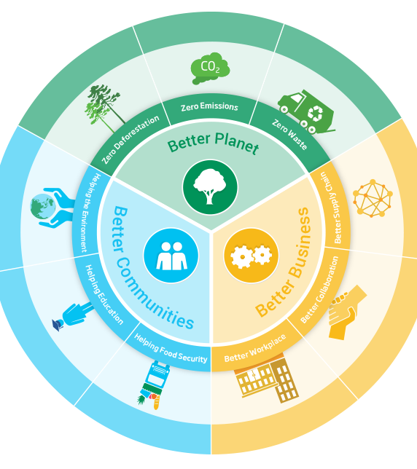
QUESTIONS?

